Slide 1

Learning Objective
I will compare and order integers.
Enter quietly, please be ready with the following on your desk:
Whiteboard
Whiteboard marker
Exercise Book
Pencil, pen, ruler and red pen
Diary
Calculator
Device – charged or borrowed from Library before maths

Slide 2
Daily Review
CFU 2
CFU 1
How do we find the LCM using this method? (Step 4)
How do we find the HCF using this method? (Step 3)
To find the HCF and LCM using factor trees:
Draw a factor tree of both numbers.
25
25 = 5 x 5
Write the numbers in expanded form.
50
50 = 2 x 5 x 5
Highlight the common numbers in the first list.
HCF of 25 and 50
= 5 x 5
= 25
Multiply the highlighted numbers to find the HCF.
LCM of 25 and 50
= 50
Multiply the second number with the leftover numbers from the first to find the LCM.

Slide 3
Daily Review
CFU 2
CFU 1
How do we find the LCM using this method? (Step 4)
How do we find the HCF using this method? (Step 3)
To find the HCF and LCM using factor trees:
Draw a factor tree of both numbers.
99
99 = 3 x 3 x 11
Write the numbers in expanded form.
66
66 = 2 x 3 x 11
Whiteboards
Highlight the common numbers in the first list.
Multiply the highlighted numbers to find the HCF.
Multiply the second number with the leftover numbers from the first to find the LCM.

Slide 4
Daily Review
CFU 2
CFU 1
How do we find the LCM using this method? (Step 4)
How do we find the HCF using this method? (Step 3)
To find the HCF and LCM using factor trees:
Whiteboards
Draw a factor tree of both numbers.
52
Write the numbers in expanded form.
32
Highlight the common numbers in the first list.
Multiply the highlighted numbers to find the HCF.
Multiply the second number with the leftover numbers from the first to find the LCM.

Slide 5
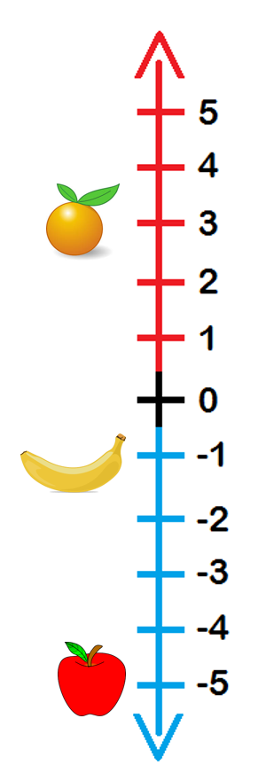
Learning Objective
CFU
What will we learn today?
CFU
I will compare and order integers.
How will you know that you are successful?
Success Criteria
At the end of the lesson, I will be able to:
Identify the properties of an integer.
Interpret worded statements in terms of integers.
Use the inequality symbols to compare integers.
Place integers into ascending and descending order.

Slide 6
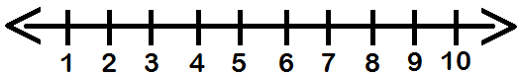
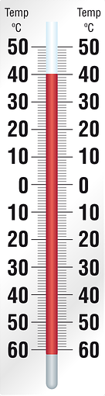
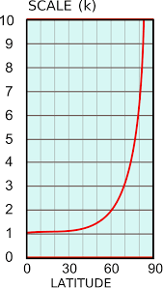
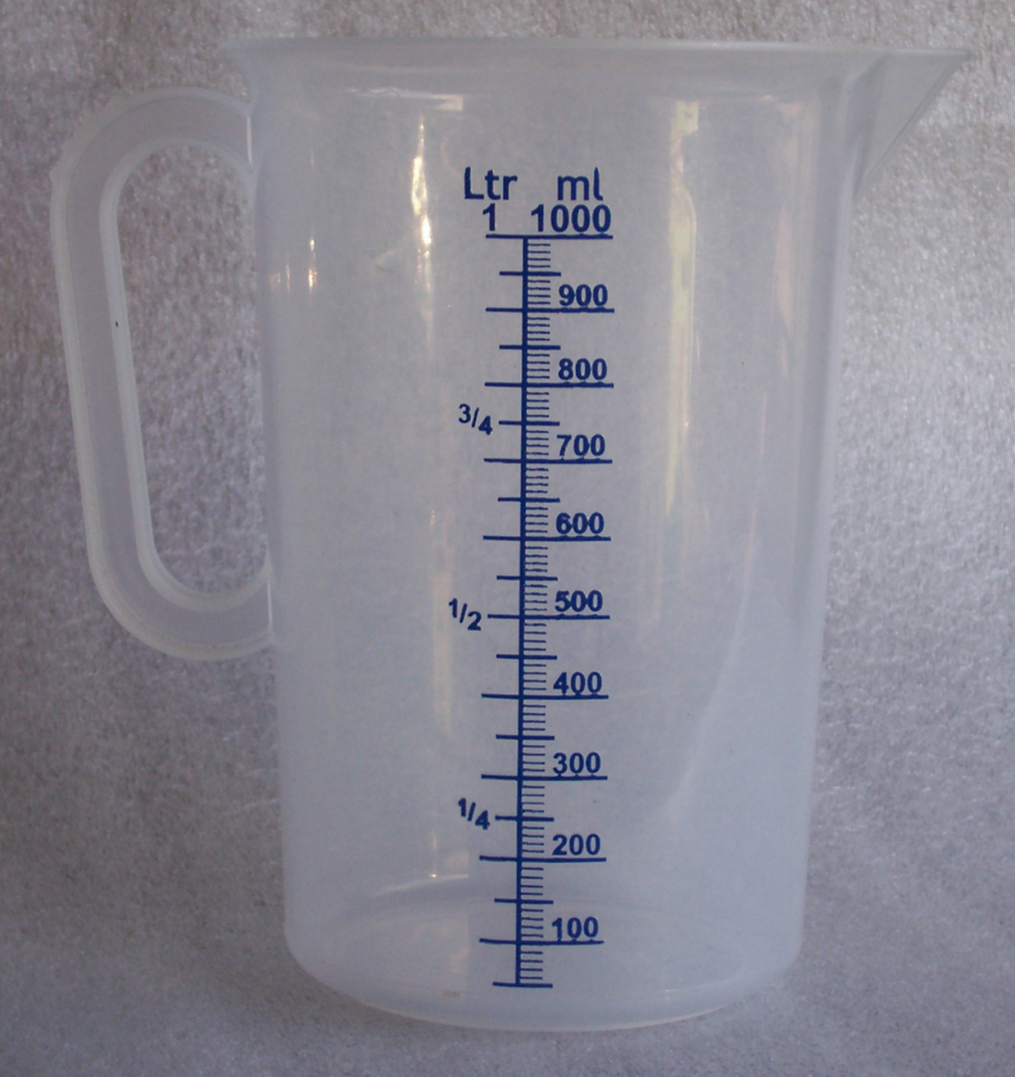
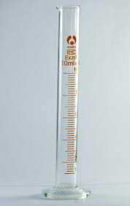
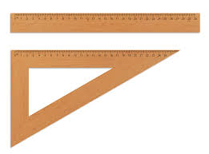
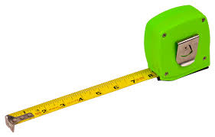
Activate Prior Knowledge
Here is a number line.
Can you think of any number lines we use in the real world?

Slide 7


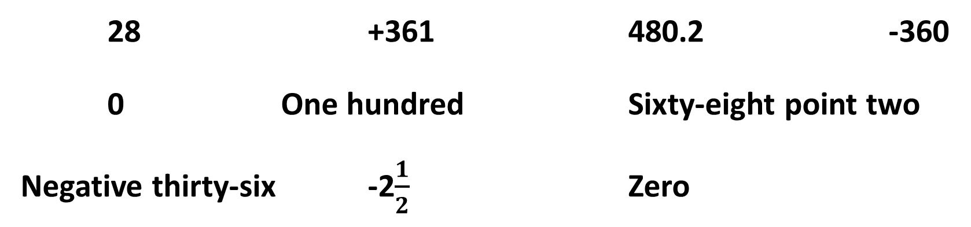
Concept Development
VOCABULARY
Integer – A whole number.
An integer is a whole number.
This includes all of the positive whole numbers, all of the negative whole numbers and zero (which is neither positive nor negative).
CFU
What is an integer?
CFU
Is zero an integer?
We assume that a number with no +/- sign is positive.
Which of these are integers?
28 +361 480.2 -360
0 One hundred Sixty-eight point two
Negative thirty-six -2$\frac{1}{2}$ Zero

Slide 8
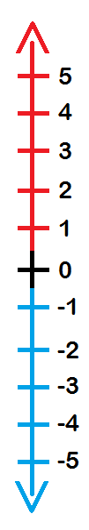



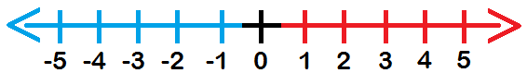
Concept Development
VOCABULARY
Integer – A whole number.
A number line can be very useful when working with integers.
A positive number line:
A vertical number line:
A positive and negative number line:

Slide 9

Concept Development
VOCABULARY
Integer – A whole number.
Direction
Size
All integers have 2 qualities:
The direction (positive/negative/neither).
The size of the number.
CFU
What are the 2 qualities of any integer?
-12
Can you identify the size and direction of the following integers?
-38
4
-9
HINT
A number with no +/- sign is positive.
+16
0

Slide 10


Skill Development
Different words can be used to describe situations where a positive or a negative number is used.
Are the following words positive or negative?
POSITIVE | NEGATIVE
Up
Gain
Deposit
Above
Increase
Profit
Down
Lose
Withdrawal
Below
Decrease
Loss
Up
Gain
Decrease
Deposit
Lose
Below
Above
Loss
Withdrawal
Down
Increase
Profit

Slide 11
Question
Which of the following words indicate positive value?
A: Below
B: Gain
C: Profit
D: Lose
E: Loss
F: Up

Slide 12
Question
Which of the following words indicate negative value?
A: Gain
B: Loss
C: Profit
D: Increase
E: Above
F: Decrease

Slide 13
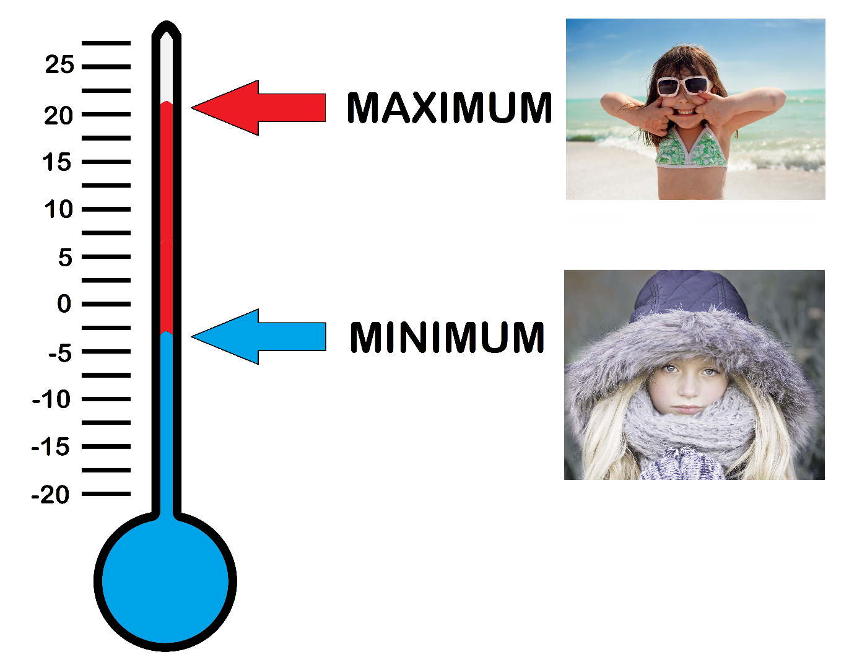
Skill Development
VOCABULARY
Integer – A whole number.
Real World Integers and Number Lines
CFU
Tomorrow’s minimum temperature will be a chilly 3 degrees Celsius below zero, followed by a maximum of 21.
What are the 2 integers in this statement?
-3
+21

Slide 14
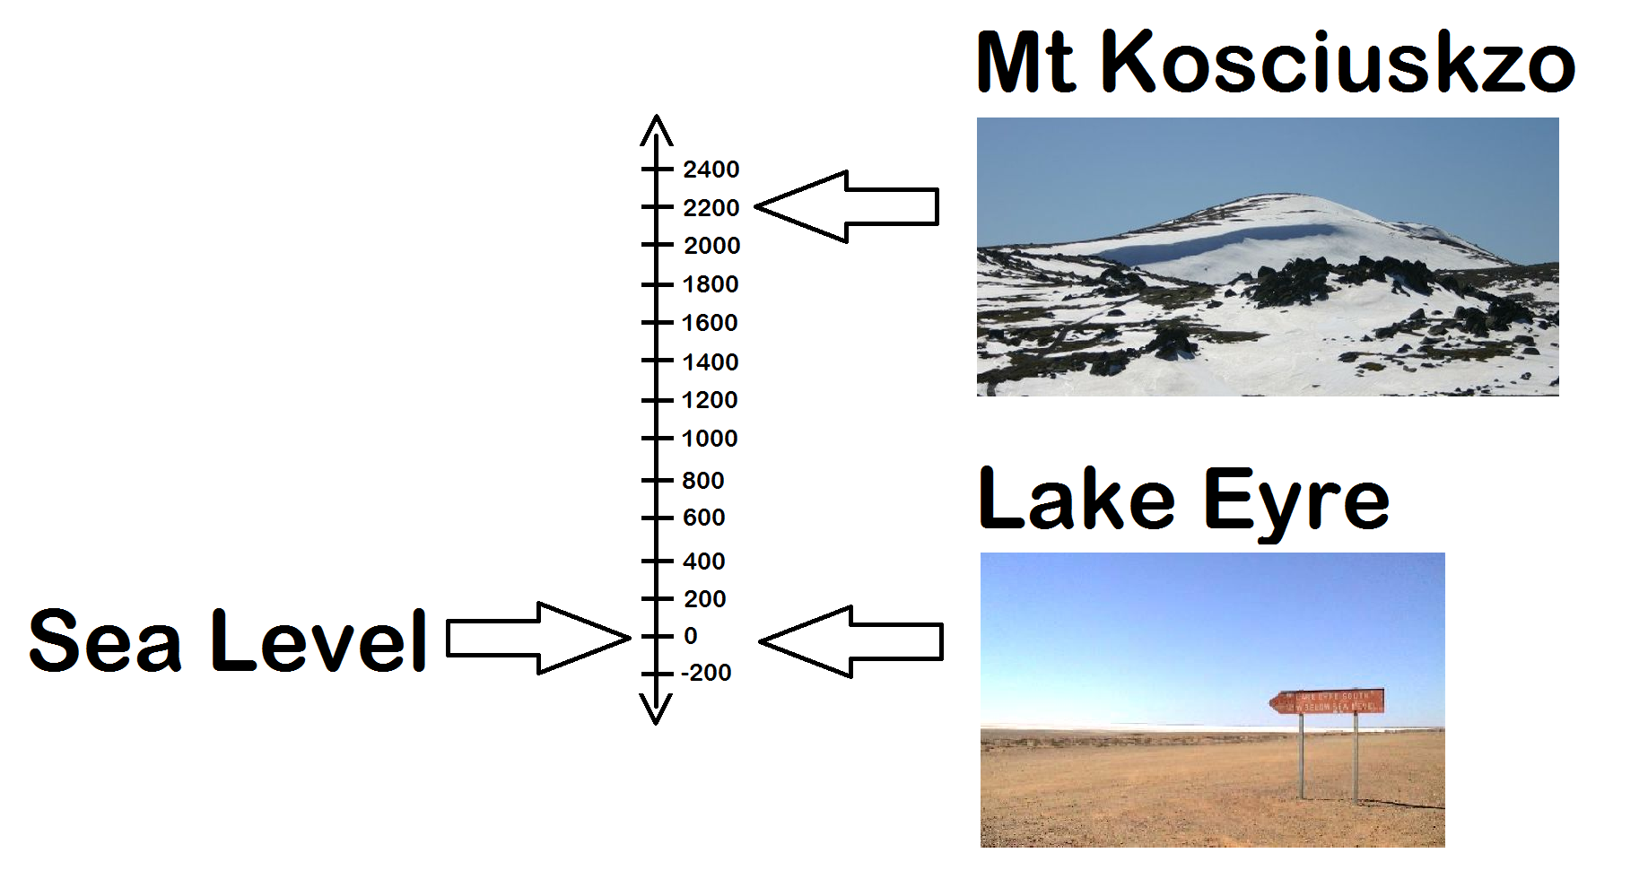
Guided Practice
VOCABULARY
Integer – A whole number.
Real World Integers and Number Lines
CFU
Mt Kosciuszko (Australia’s highest mountain) reaches 2230 m above sea level, whereas Lake Eyre is 16 m below sea level.
What are the 2 integers in this statement?
+2230
-16

Slide 15
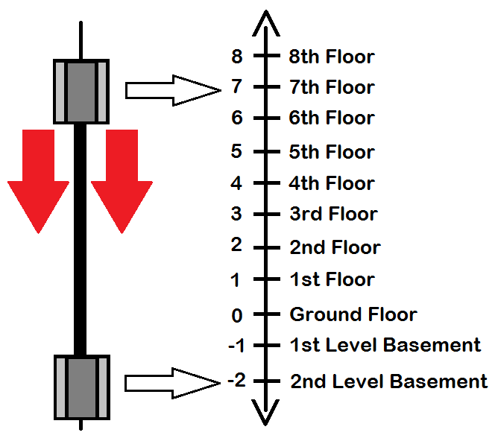
Guided Practice
VOCABULARY
Integer – A whole number.
Real World Integers and Number Lines
CFU
I take the lift from the 7th floor right down to the 2nd basement level.
What are the 2 integers in this statement?
+7
-2

Slide 16


Greater Than, Less Than
Skill Development
> <
Greater than Less than
Remember the greedy crocodile always eats the bigger number!

Slide 17


Guided Practice
HINT
The greedy crocodile always eats the bigger number
Sentence Structure
____ is greater than ___.
Which is bigger?
0 or 5
2 or -3
-1 or 1
-5 or -4
0 < 5
2 > -3
-1 < 1
-5 < -4
Whiteboards
28 or 26
111 or -222
-962 or -847
-472 or 389

Slide 18

Skill Development
VOCABULARY
Ascending means to order from smallest to largest.
Descending means to order from largest to smallest.
Put these integers in ascending order.
3, -2, 5, 8, -3 -1, 4, 6, -6, -9, 7
Put these integers in descending order.
7, -5, 8, -2, -1, 3, 5 2, -6, -5, -7, 1, 0, 5, -1
-3, -2, 3, 5, 8
-9, -6, -1, 4, 6, 7
8, 7, 5, 3, -1, -2, -5
5, 2, 1, 0, -1, -5, -6, -7

Slide 19
Guided Practice
HINT
Picture or draw a number line to help you out!
Arrange the following in ascending order:
15, 0, -1, 5, -18, -9
Whiteboards

Slide 20
Guided Practice
HINT
Picture or draw a number line to help you out!
Arrange the following in descending order:
22, -12, -5, -20, 11, 6

Slide 21
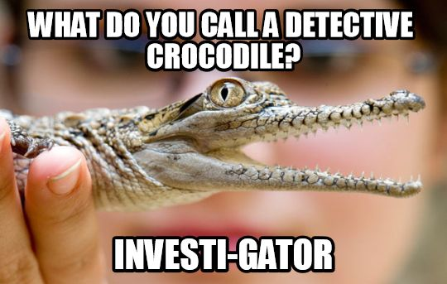
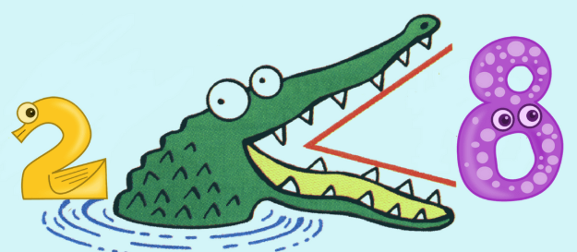
Skill Closure
What have we learnt today?
Lesson Objectives:
I will compare integers.
How do you remember greater than and less than symbols?
The greedy crocodile always eats the bigger number.

Slide 22
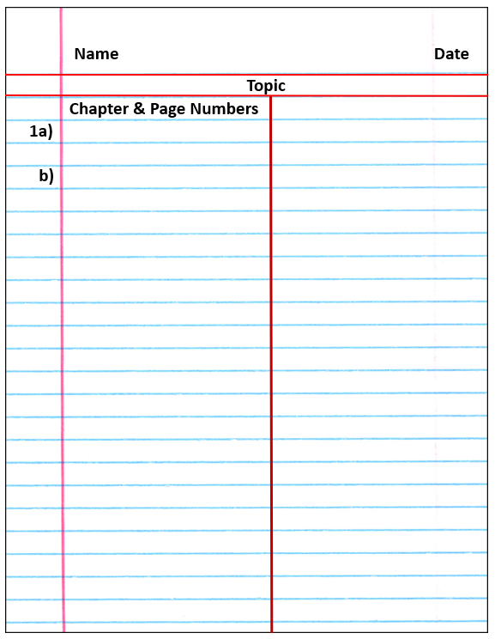

Independent Practice
Mathematics Page Layout
Open your textbooks to:
Chapter 2.4
Questions: 1-7

